Slide 1
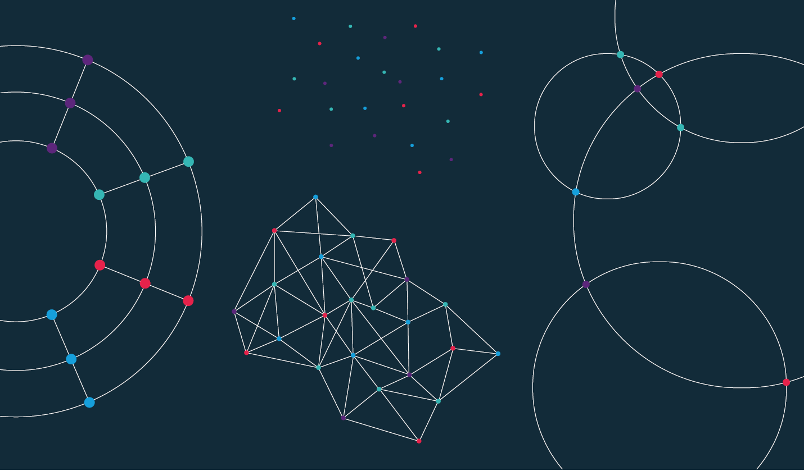

Slide 2
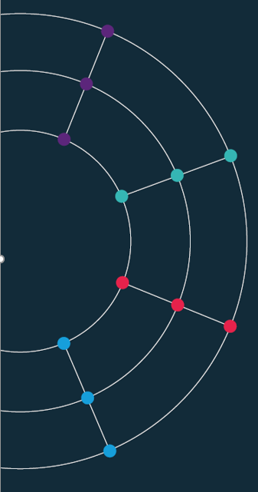
Session 1. Building your first website
[90 min]

Slide 3
Session 1. Building your first website
b. Charting principles
[90 min]
[30 min]

Slide 4
Bad, Ugly … and Good.

Slide 5
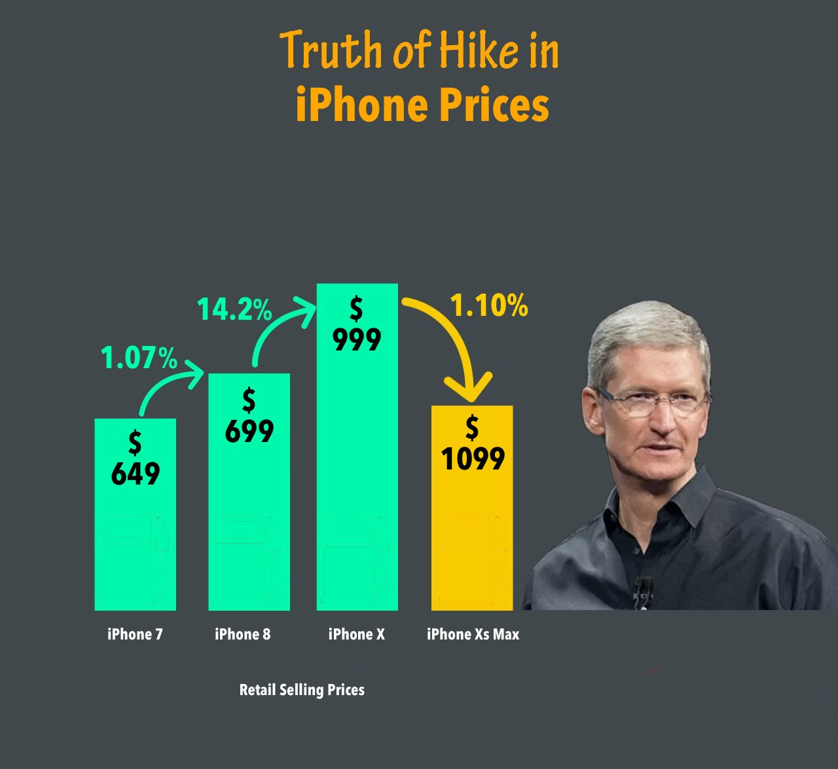
When charts go wrong.
Notes:
RS: insert example of a terrible chart

Slide 6
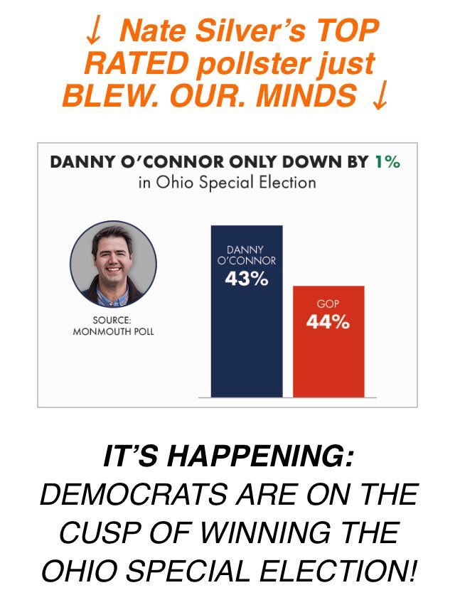
Notes:
RS: insert example of a terrible chart

Slide 7
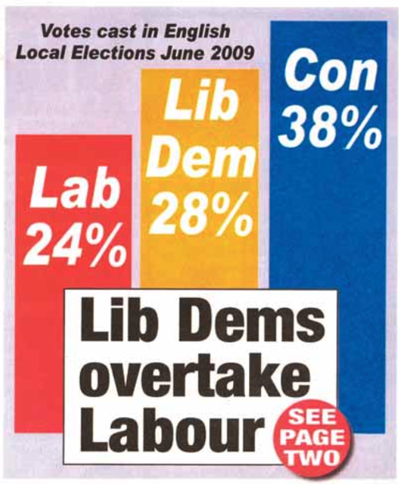
Notes:
RS: insert example of a terrible chart

Slide 8
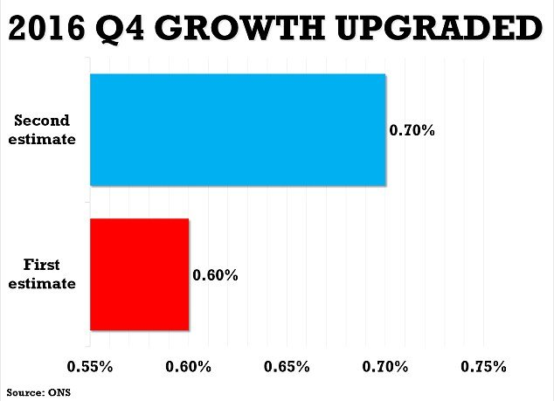
Notes:
RS: insert example of a terrible chart

Slide 9
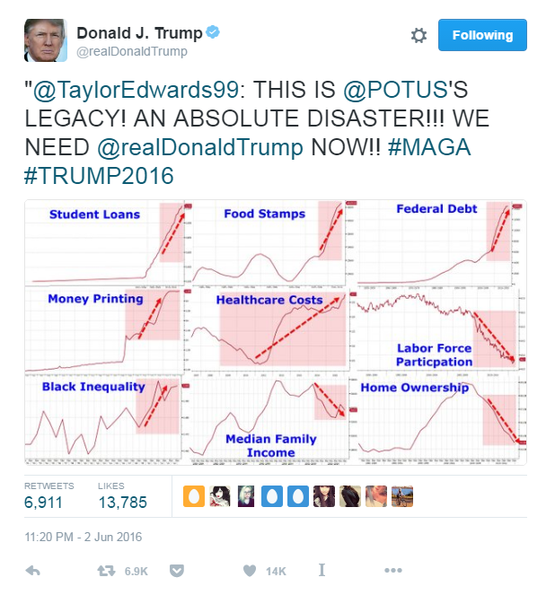
Notes:
RS: insert example of a terrible chart

Slide 10
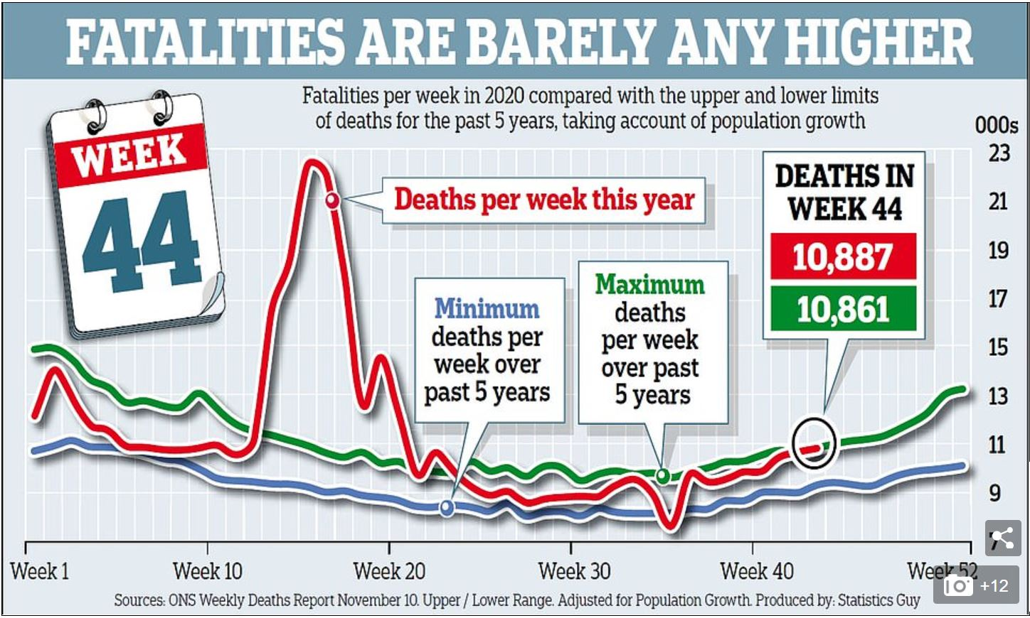
Source: Daily Mail, November 20th 2020

Slide 11

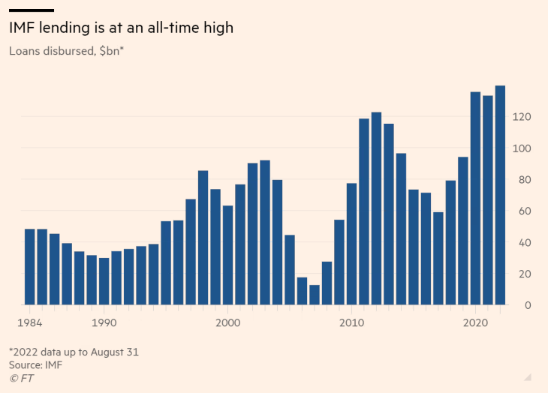
https://www.ft.com/content/eddedee3-669d-42cc-9597-33609a8bff99

Slide 12
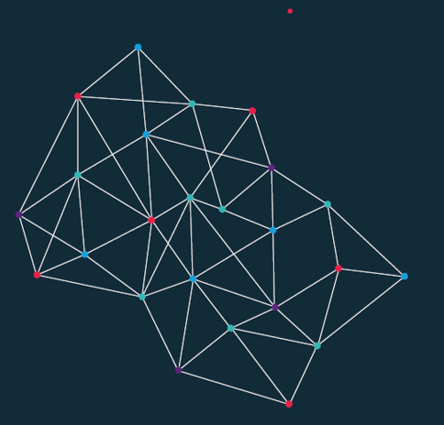
Two worked examples. What is wrong here? And how can we improve things?

Slide 13
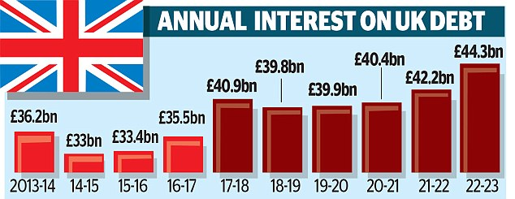
Source: Daily Mail, 2 Jan 2018

Slide 14
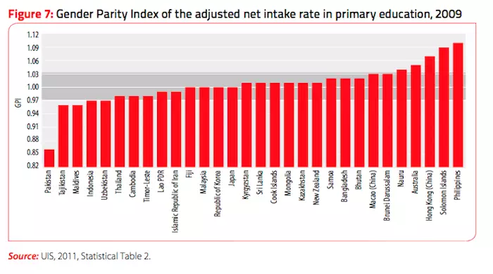

Slide 15
The same data Different stories

Slide 16
Source: Daily Mail, 2 Jan 2018

Slide 20
Source: Daily Mail, 2 Jan 2018

Slide 21
SHARE OF NATIONAL INCOME SPENT ON UK DEBT

Slide 24
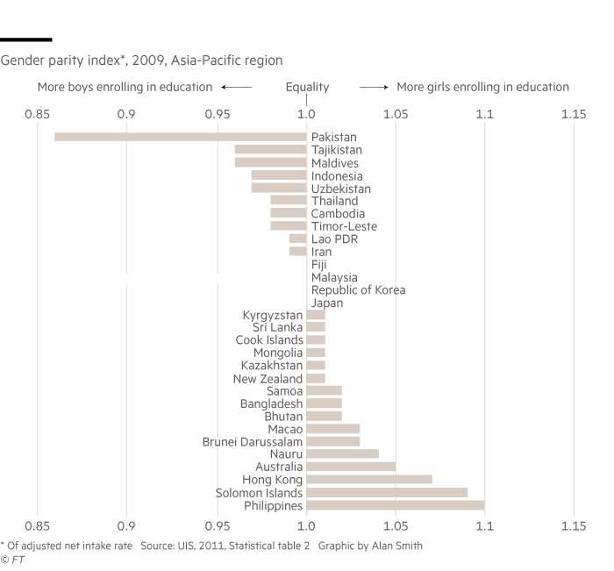

Slide 25
Dataviz heroes. Playfair, Nightingale and other pioneers

Slide 26
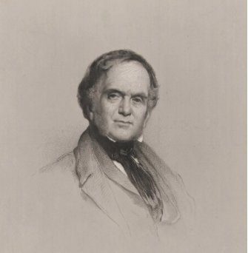
William Playfair.
Born in 1759, William Playfair invented the chart.
The Commercial and Political Atlas (1785) which featured 40 charts covering trade, debt, expenditure and other economic matters
Playfair was the first to add the vertical axis (previous charts did not have this feature, meaning the way data were stacked vertically meant nothing).
His charts were relevant to policy. Playfair made charts that demand those in charge of policy to pay attention
“Information, that is imperfectly acquired, is generally as imperfectly retained; and a man who has carefully investigated a printed table, finds, when done, that he has only a very faint and partial idea of what he has read; and that like a figure imprinted on sand, is soon totally erased and defaced.”
Notes:
RS: insert example of a terrible chart

Slide 27
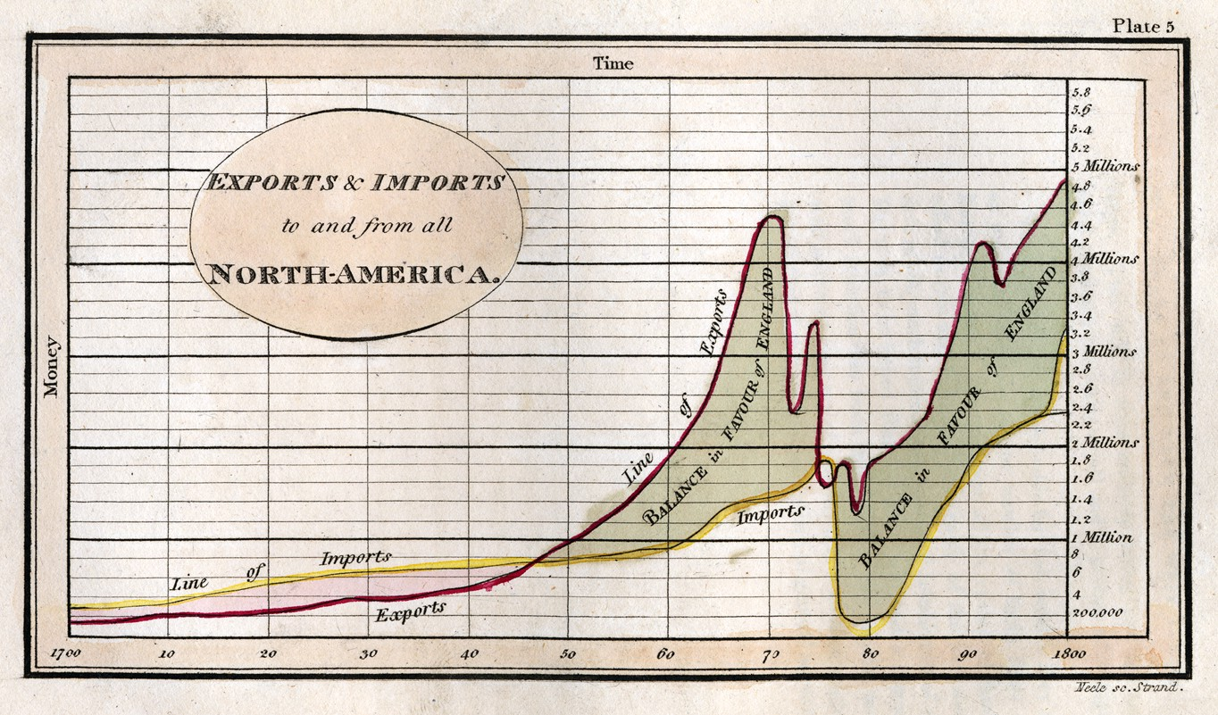
Politics and trade.

Slide 28
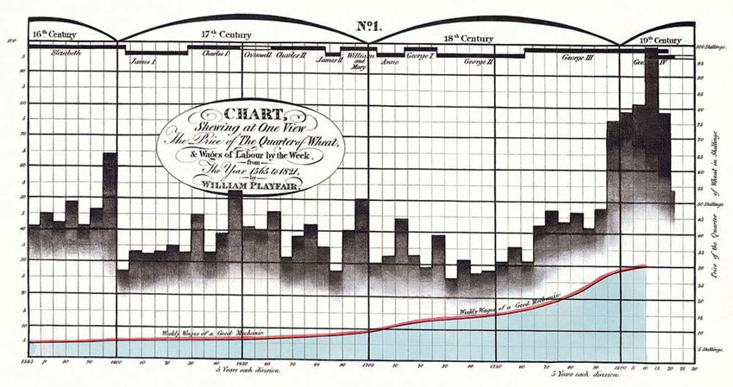
Real wages.

Slide 29
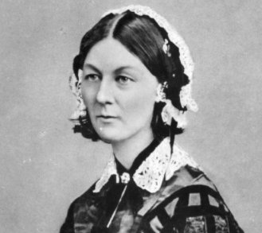
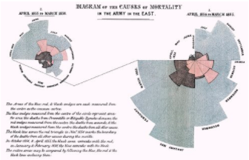
Florence Nightingale.
Born in 1820, she was a disruptor of both medicine and data
Statistician, campaigner, nurse, and inventor, she is best known as the founder of modern nursing: the lady with the lamp
After working on the frontline during the Crimean war, she decided to communicate the miserable conditions she witnessed, creating pioneering using data visualisations to make her case

Slide 30
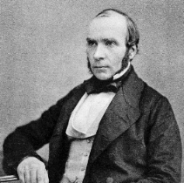
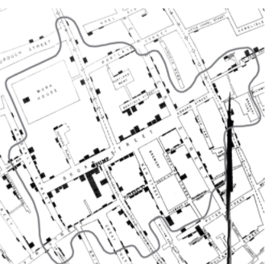
John Snow.
John Snow was an English physician
Studied 1854 cholera epidemic in London
Founding father of epidemiology, a branch of medicine that studies the contraction, spreading and control of disease.
Data pioneer, using carefully plotted maps to solve a problem that had defeated scientists of his day
Story of the Broad Street pump
Notes:
RS: insert example of a terrible chart

Slide 31
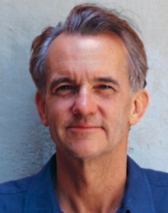
Edward Tufte.
The American statistician and graphic design theorist.
The Visual Display of Quantitative Information, April 1983
Primary message: designers didn’t have to sacrifice mathematical accuracy in the quest for elegance
“data-ink ratio” to measure the proportion of a given graphic which was simply illustration rather than a representation of data.
He questioned the “data density” of graphics. And for those graphics which his disliked most coined a new word: “chartjunk”.
Notes:
RS: insert example of a terrible chart

Slide 32
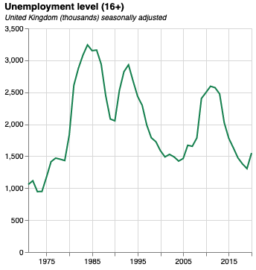
Anatomy of a good chart.
Size. The original version of this chart is 300px by 300px. This is perfect for mobile.
Y axis metric included in the title
Eye-catching colour. Make sure colours are consistent across your work
Subtitle including extra detail (such as units)
Y axis label not needed because of title
X axis label not needed because, in most cases, time is obvious
Quantitative data should start from zero by default
Notes:
RS: insert example of a terrible chart

Slide 33
Session 4. Visualisation and advanced analytics
The grammar of graphics
[90 min]
[30 min]

Slide 34
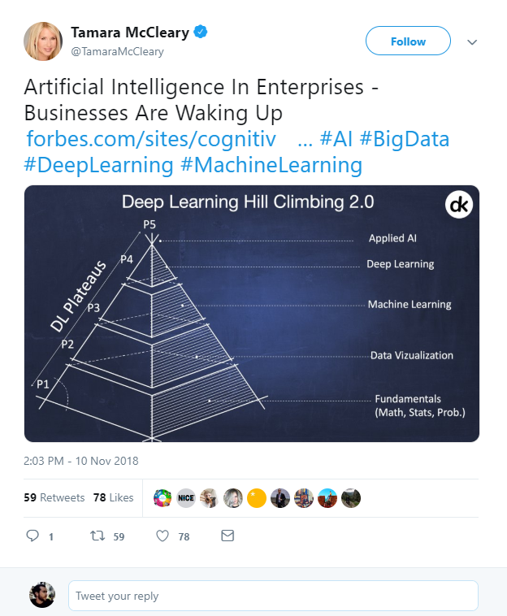

What is Data Science?
Artificial Intelligence?
Machine Learning?
Deep Learning?
Big Data?
https://twitter.com/TamaraMcCleary/status/1061197523610550272
Notes:
Tamara MCcleary – Tech Influencer
The data science pyramid
What do some of the more “fashionable” terms mean?
https://twitter.com/TamaraMcCleary/status/1061197523610550272

Slide 35

1 ZB zeta-exa-peta terra-giga-mega
Norhteastern, 2016
Notes:
In one year, humanity generates around 1ZB of data.
www.northeastern.edu/graduate/blog/how-much-data-produced-every-day/
If you take an average 10GB phone, that means 100 billion of phones.
If you take these phones and you stack them, screen to back, you could build one million 800m tall towers.
That is one Burj Khalifa for every pixel on this screen.

Slide 36
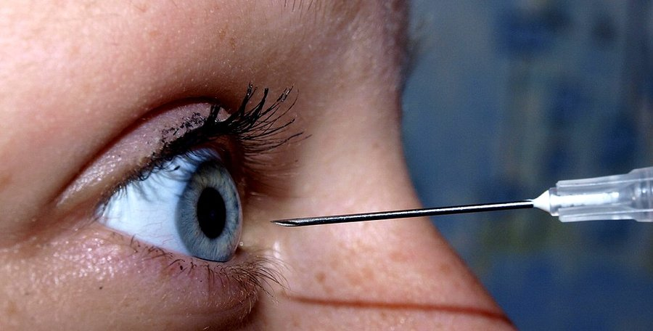
Attention ? At tension ?
Notes:
Data is practically infinite. But is your attention, too?

Slide 37
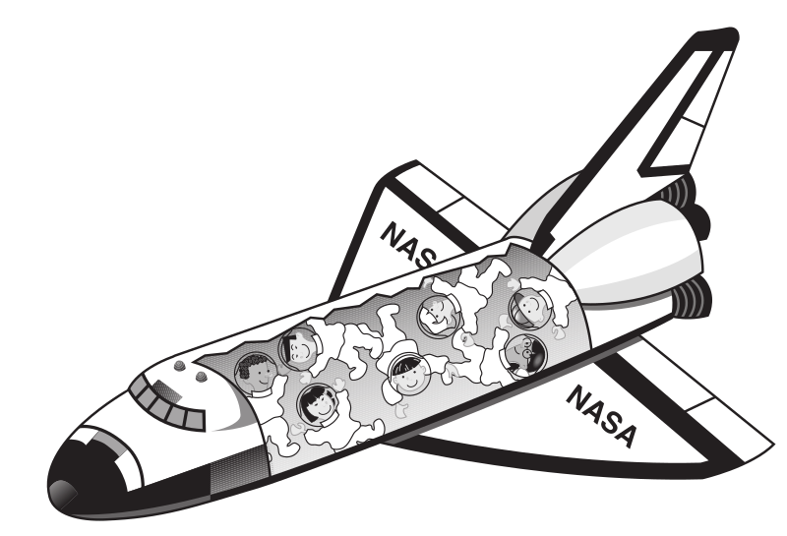

250 ms
Sabine Kastner et al., Princeton, 2018
Notes:
Sabine Kastner et al., Princeton, 2018
Your brain effectively has quarter of a second to decide what is important and what is not.

Slide 38
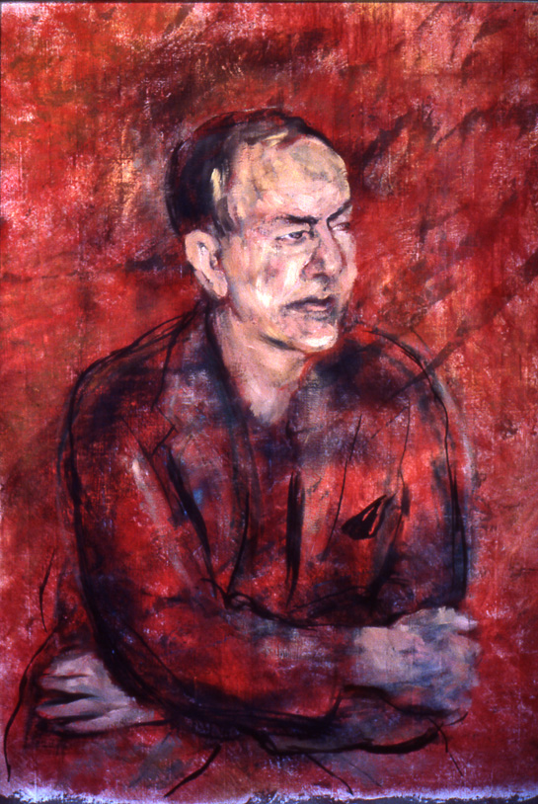
Attention poverty
"What information consumes is rather obvious: it consumes the attention of its recipients. Hence, a wealth of information creates a poverty of attention, and a need to allocate that attention efficiently among the overabundance of information sources that might consume it."
Herb Simon, as quoted by Hal Varian, Scientific American, 1995. Adapted from UW CSE442 and the original research by PARC UIR
Notes:
There is an overload of information.
We need a way to figure out what is important and what is not.

Slide 39
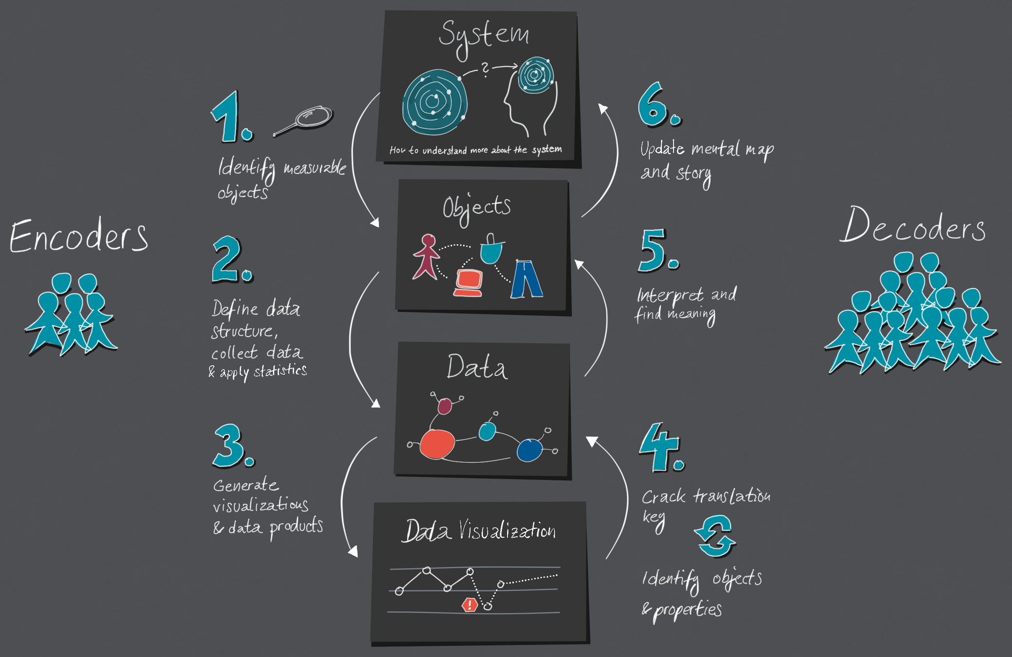

https://medium.com/nightingale/the-cycle-of-encoding-and-decoding-f3ff17010631
Notes:
Data visualisation is a language of conversing with data.
https://medium.com/nightingale/the-cycle-of-encoding-and-decoding-f3ff17010631

Slide 40


Big Data. Big Responsibility.
The Datasaurus, Autodesk, Alberto Cairo, 2017
Notes:
So there is too much data, but our attention is limited.
The art is then to extract what is important from that huge pile of data.
Welcome to Data Science.

Slide 41

Visual language is a sign system.
Images perceived as a set of signs.
Sender encodes information in signs.
Receiver decodes information from signs.
In his foreword to the 1983 English translation Howard Wainer called Bertin's work, the most important work on graphics since the publication of Playfair's Atlas
Jacques Bertin, Semiologie Graphique, 1967

Slide 42
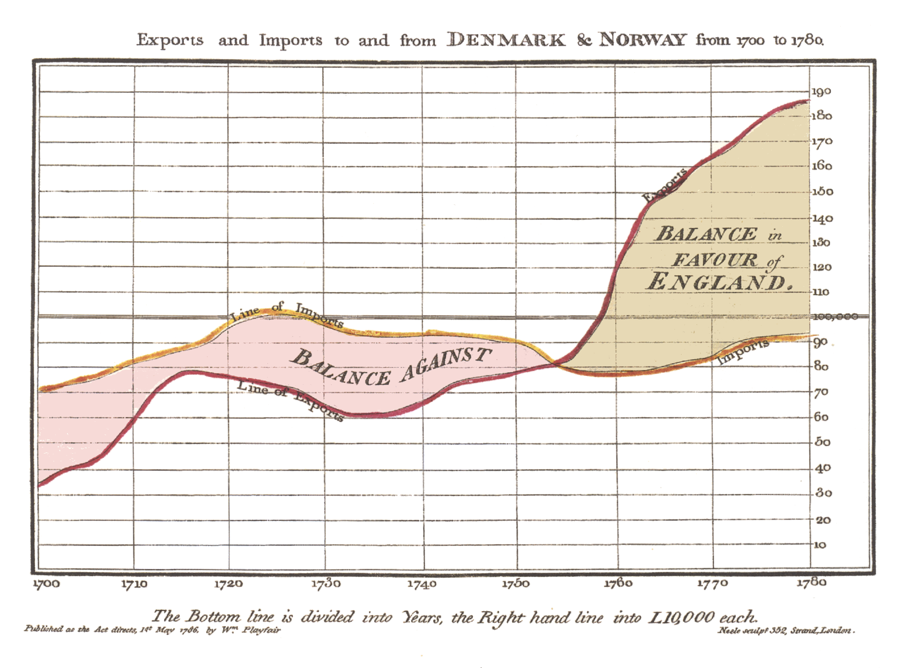
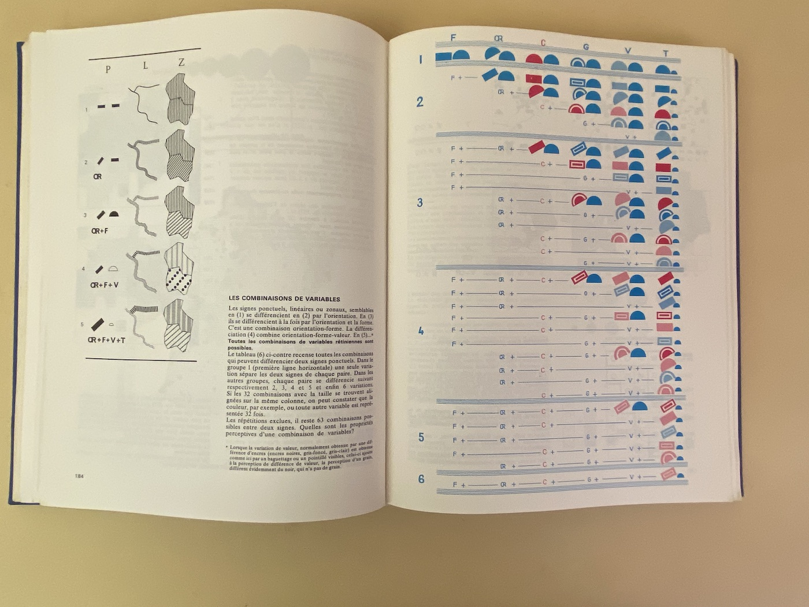
Visual language is a sign system.
William Playfair, The Commerical and Political Atlas, 1785 and Jacques Bertin, Semiologie Graphique, 1967
both collected from Jemery Norman’s HistoryOfIformation.com, 2021
Notes:
https://www.historyofinformation.com/detail.php?entryid=2929
https://www.historyofinformation.com/detail.php?id=3361

Slide 43
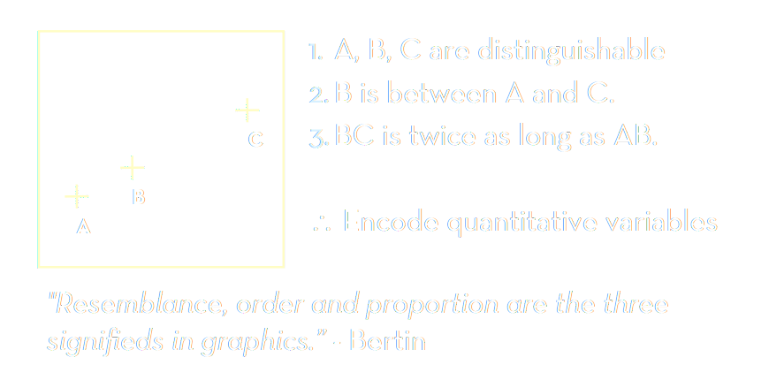
Bertin’s semiology of graphics.
Adapted from Jeffrey Heer, 2018, UW CSE442, after Jacques Bertin, Semiologie Graphique, 1967
Notes:
https://www.historyofinformation.com/detail.php?entryid=2929
https://www.historyofinformation.com/detail.php?id=3361

Slide 44
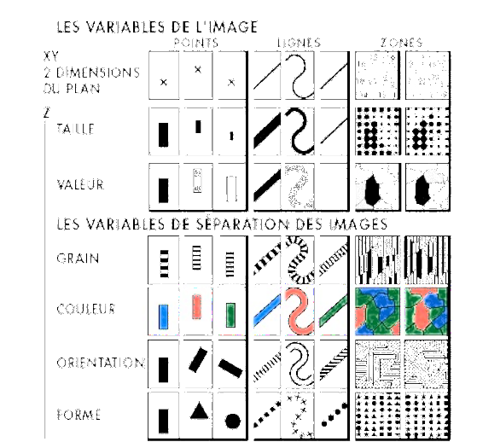
Visual encoding variables. Visual Grammar.
Position (x2)
Size
Value (Saturation)
Texture
Colour
Orientation
Shape
(Time/Animation, Focus, Opacity)
Adapted from Jeffrey Heer, 2018, UW CSE442, after Jacques Bertin, Semiologie Graphique, 1967
Notes:
https://www.historyofinformation.com/detail.php?entryid=2929
https://www.historyofinformation.com/detail.php?id=3361

Slide 45
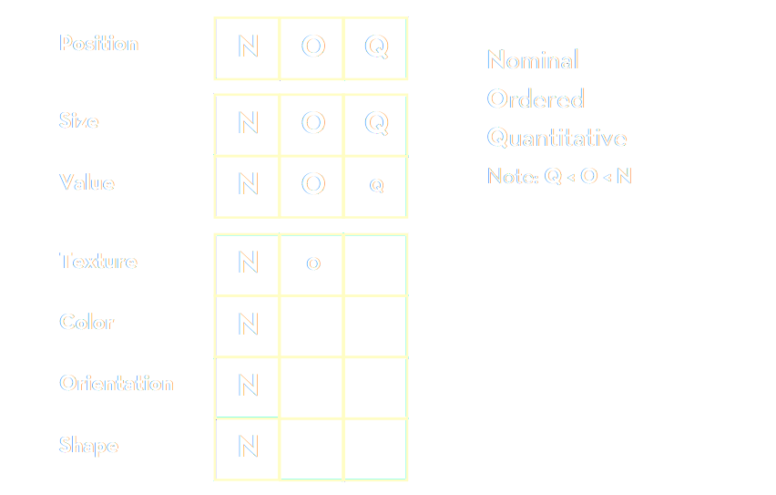
Bertin’s “Levels of Organisation”
Bertin’s list: based on theoretical considerations of semiology
Adapted from Jeffrey Heer, 2018, UW CSE442, after Jacques Bertin, Semiologie Graphique, 1967
Notes:
Bertin’s list – based on theoretical considerations of semiology

Slide 46
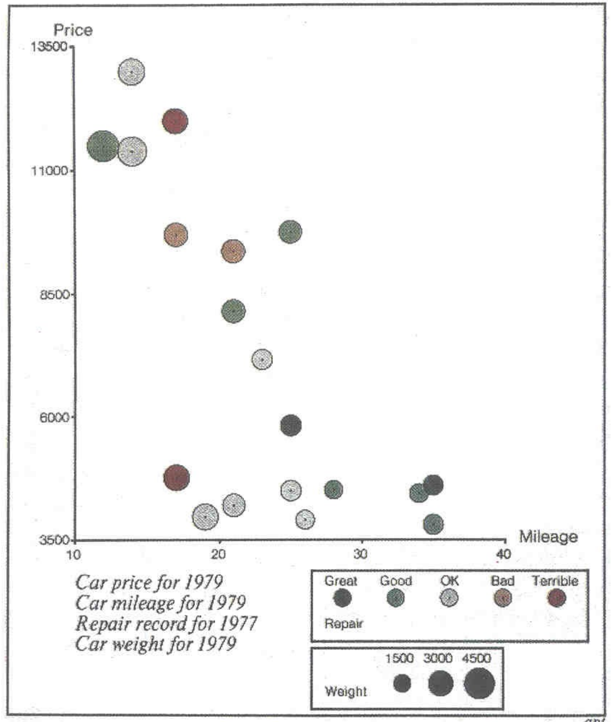
Mackinlay design criteria.
Formalizes Bertin for machines.
Expresiveness A set of facts is expressible in a visual language if the sentences (i.e. the visualisations) express all the facts in the set of data, and only the facts.
Effectiveness A visualisation is more effective than another if the information conveyed by one visualisation is more readily perceived than the information in the other visualization.
Adapted from Jeffrey Heer, 2018, UW CSE442 and Jock Mackinlay’s presentation at Ohio State University, 2005,
both based on Jock Mackinlay, Tableau/Xerox PARC/Stanford 1986
Notes:
http://web.cse.ohio-state.edu/~machiraju.1/teaching/CSE5544/mackinlay_midterm_material.pdf
Vice President of Visual Analysis at Tableau
https://www.tableau.com/learn/whitepapers/data-storytelling-using-visualization-share-human-impact-numbers

Slide 47
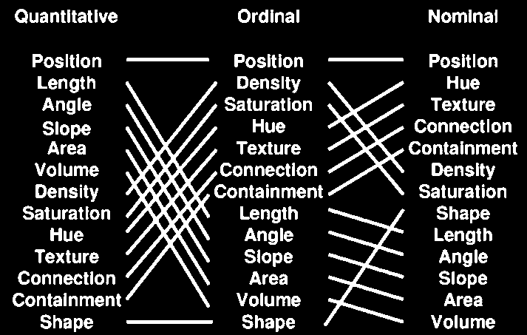
Mackinlay design criteria.
Mackinlay’s list: based on his experiments with computer graphics, trying to automate and formalize the creation of charts
The Vega visual language/grammar is built on Mackinlay’s work
Jock Mackinlay, Tableau/Xerox PARC/Stanford 1986
Notes:
Mackinlay’s list – based on his experiments with computer graphics, trying to automate and formalize the creation of charts
The first charting algorithms. The Vega visual language/grammar is built on Mackilnay’s work.

Slide 48
Which square is lighter?
Notes:
http://web.cse.ohio-state.edu/~machiraju.1/teaching/CSE5544/mackinlay_midterm_material.pdf
Vice President of Visual Analysis at Tableau
https://www.tableau.com/learn/whitepapers/data-storytelling-using-visualization-share-human-impact-numbers

Slide 49
Which square is lighter?
217, 217, 217
> 2 %
212, 212, 212
Notes:
http://web.cse.ohio-state.edu/~machiraju.1/teaching/CSE5544/mackinlay_midterm_material.pdf
Vice President of Visual Analysis at Tableau
https://www.tableau.com/learn/whitepapers/data-storytelling-using-visualization-share-human-impact-numbers

Slide 50
How many times is the right circle larger?
Notes:
http://web.cse.ohio-state.edu/~machiraju.1/teaching/CSE5544/mackinlay_midterm_material.pdf
Vice President of Visual Analysis at Tableau
https://www.tableau.com/learn/whitepapers/data-storytelling-using-visualization-share-human-impact-numbers

Slide 51
How many times is the top bar longer?
7
Notes:
http://web.cse.ohio-state.edu/~machiraju.1/teaching/CSE5544/mackinlay_midterm_material.pdf
Vice President of Visual Analysis at Tableau
https://www.tableau.com/learn/whitepapers/data-storytelling-using-visualization-share-human-impact-numbers

Slide 52
What colour do you see?
Notes:
http://web.cse.ohio-state.edu/~machiraju.1/teaching/CSE5544/mackinlay_midterm_material.pdf
Vice President of Visual Analysis at Tableau
https://www.tableau.com/learn/whitepapers/data-storytelling-using-visualization-share-human-impact-numbers

Slide 53
What colour do you see?
Notes:
http://web.cse.ohio-state.edu/~machiraju.1/teaching/CSE5544/mackinlay_midterm_material.pdf
Vice President of Visual Analysis at Tableau
https://www.tableau.com/learn/whitepapers/data-storytelling-using-visualization-share-human-impact-numbers

Slide 54
What colour do you see?
Notes:
http://web.cse.ohio-state.edu/~machiraju.1/teaching/CSE5544/mackinlay_midterm_material.pdf
Vice President of Visual Analysis at Tableau
https://www.tableau.com/learn/whitepapers/data-storytelling-using-visualization-share-human-impact-numbers

Slide 55

Stevens’ power law.
length
taste
weight
shock
sensation = intensity^{exponent}
Our senses are not linear!
area
volume
loudness
sensation →
intensity →
Stanley Smith Stevens, Harvard, 1957
Notes:
http://web.cse.ohio-state.edu/~machiraju.1/teaching/CSE5544/mackinlay_midterm_material.pdf
Vice President of Visual Analysis at Tableau
https://www.tableau.com/learn/whitepapers/data-storytelling-using-visualization-share-human-impact-numbers

Slide 56
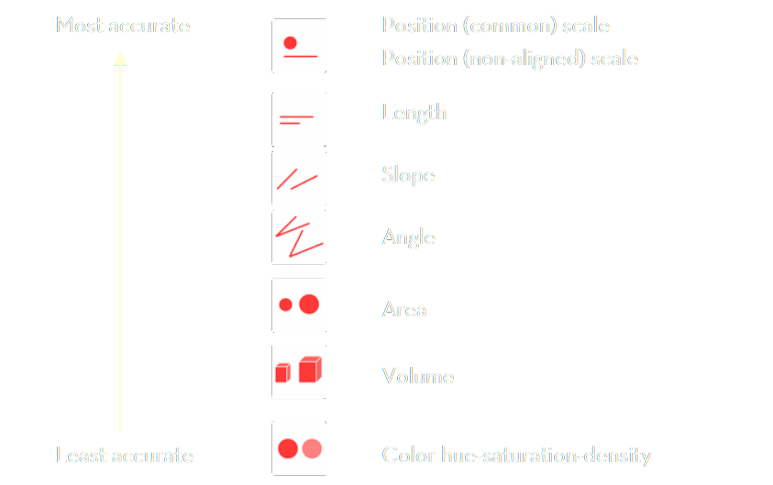
Stevens’ power law.
Stevens’ list: based on psychological experiments with human senses
Stanley Smith Stevens, Harvard, 1957

Slide 57
Visual language is a sign system.
When designing visual information use correct encodings
data → information correct data model
information → knowledge correct visual representation
Bertin’s semiology of graphics
Mackinlay design criteria
Stevens’ power law

Slide 58
Data visualization zoo.
The actual “A Tour through the Visualisation Zoo”
Economics Observatory 🌌 Visualisation Guidelines
Financial Times Visual Vocabulary
Vega Edition of the Visual Vocabulary
The D3 Graph Gallery
Andy Kirks's The Chartmaker Directory
Heer, Bostock, Ogievetsky, A Tour through the Visualization Zoo, ACM, 2010
Notes:
https://homes.cs.washington.edu/~jheer/files/zoo/

Slide 59
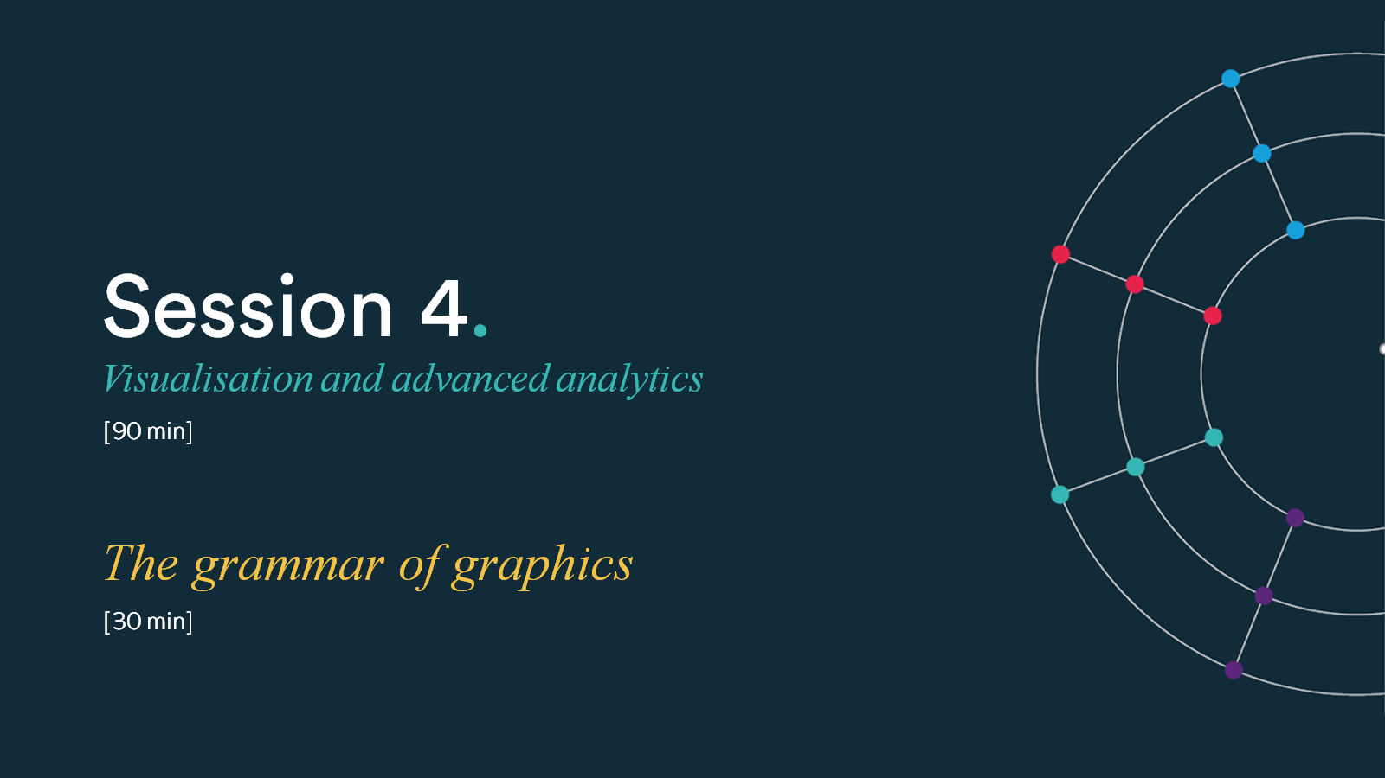
Session 4. Visualisation and advanced analytics
Chart types – code-along
[90 min]
[30 min]

